Slide 1
PointNET AE
By Elvis Kimara

Slide 2

Was able to make a PointNET AE
Added code to control the latent size of the last layer
Tested results of different latent vector sizes
Train the model on multiple point clouds

Slide 3
Was able to make a PointNET encoder, decoder, and autoencoder structure
PointNet Encoder
Input: 3D point cloud [batch, channels, points].
Layers: 3 Conv1D layers (3 → 64 → 128 → output_size).
Activation: ReLU after first two convolutions.
Feature Aggregation: Max pooling for global feature vector.
PointNet Decoder
Input: Encoded latent space representation.
Layers: 3 Fully Connected layers (latent_size → 512 → 256 → num_points*3).
Activation: ReLU after first two FC layers.
Output: Reconstructed point cloud [batch, num_points, 3].
End-to-End Training
Objective: Minimize difference between original and reconstructed point cloud.
Process: Input → Encoder → Latent Space → Decoder → Reconstructed Output.

Slide 4
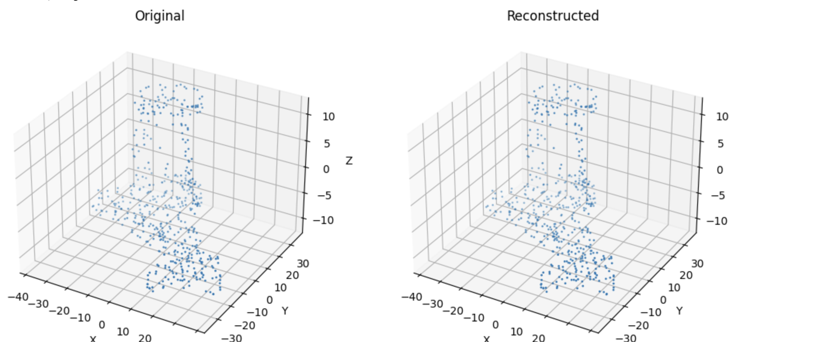
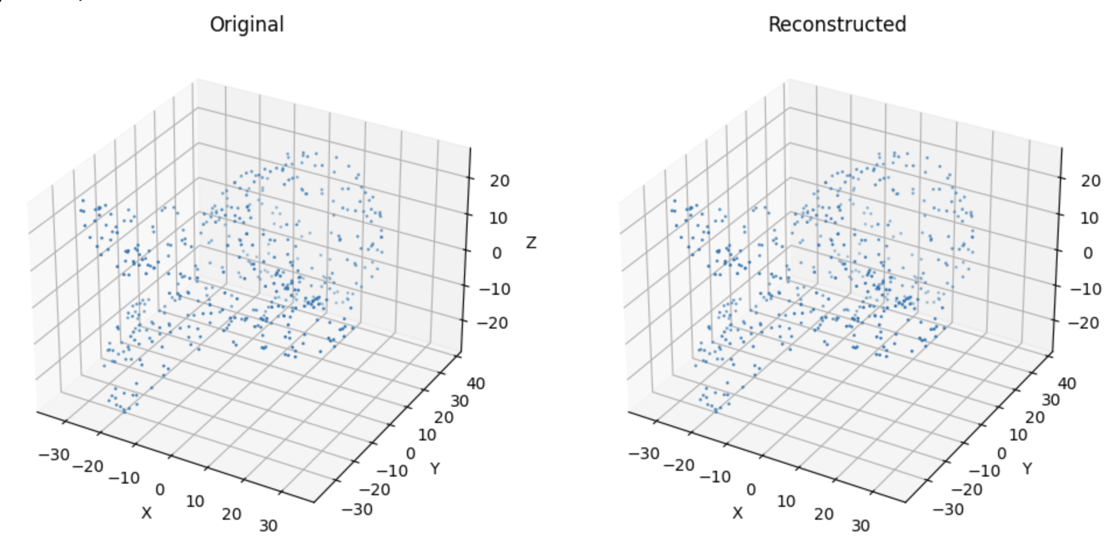
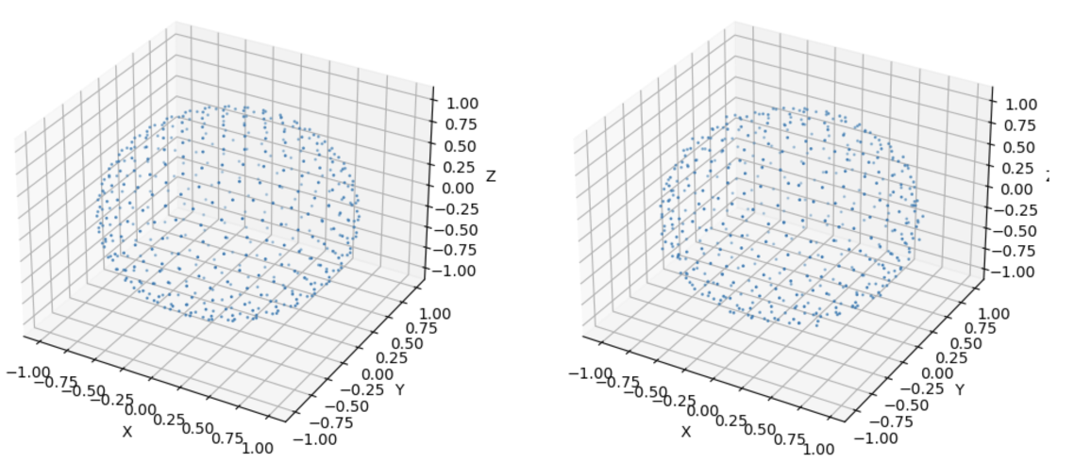
Was able to Train model on multiple point clouds
Notes:
Each PC for set epochs
Name the Point Clouds so it makes sense

Slide 5
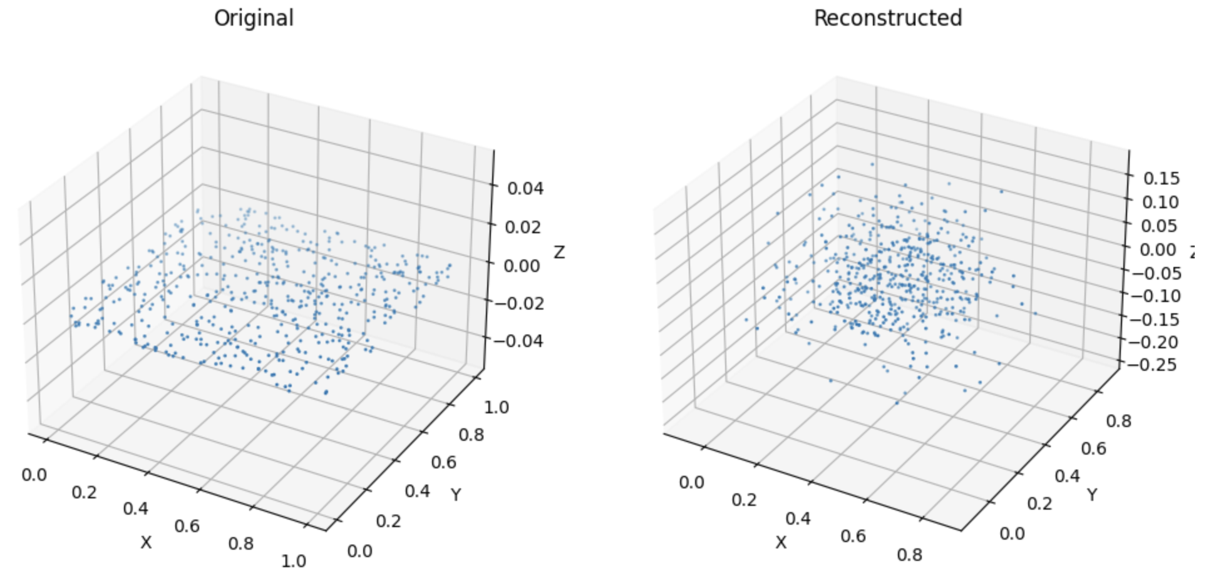
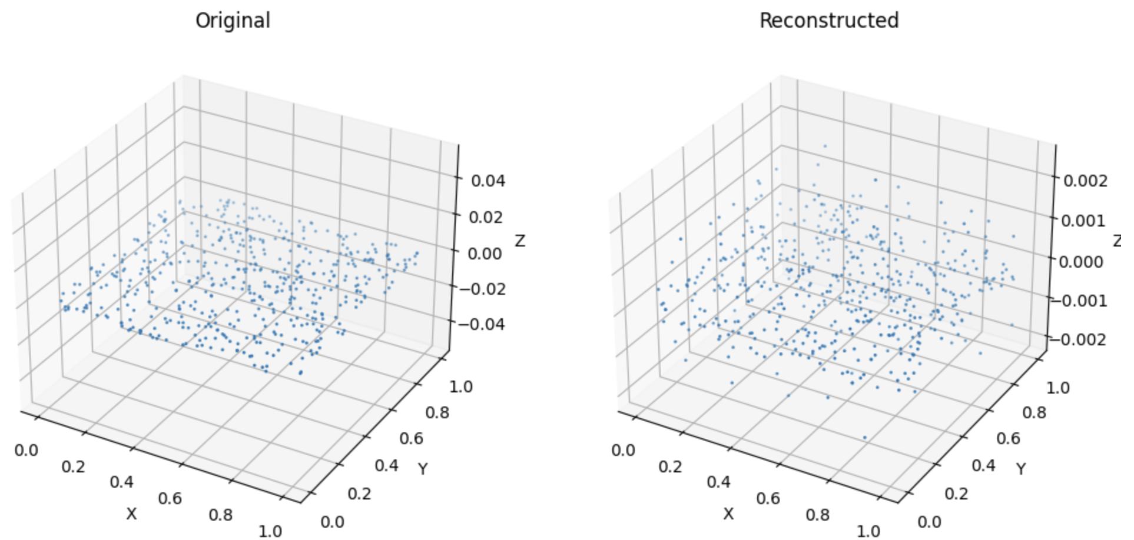
Model Gets better with more epochs

Slide 6
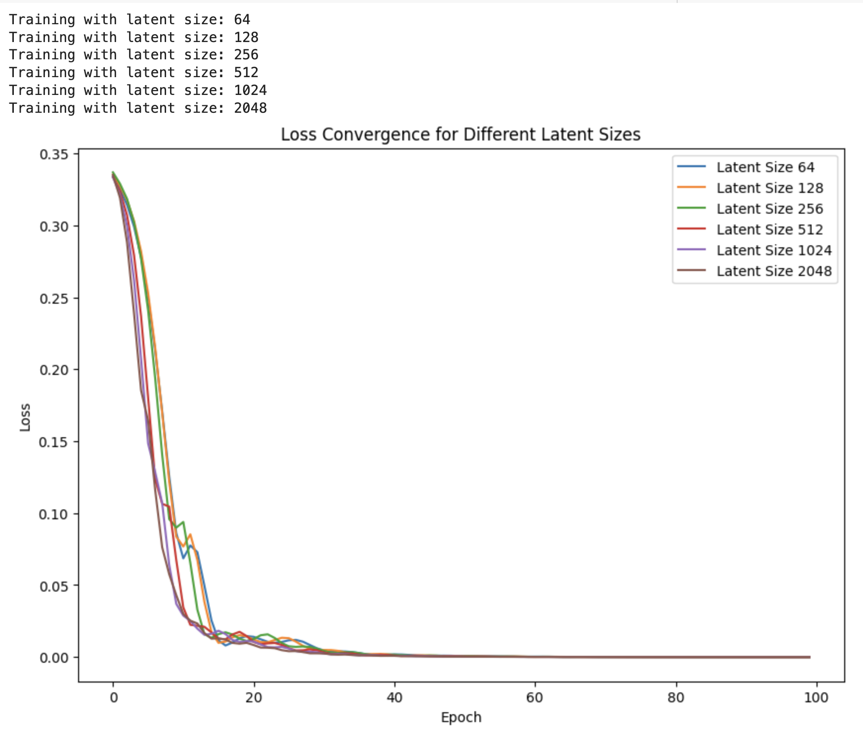
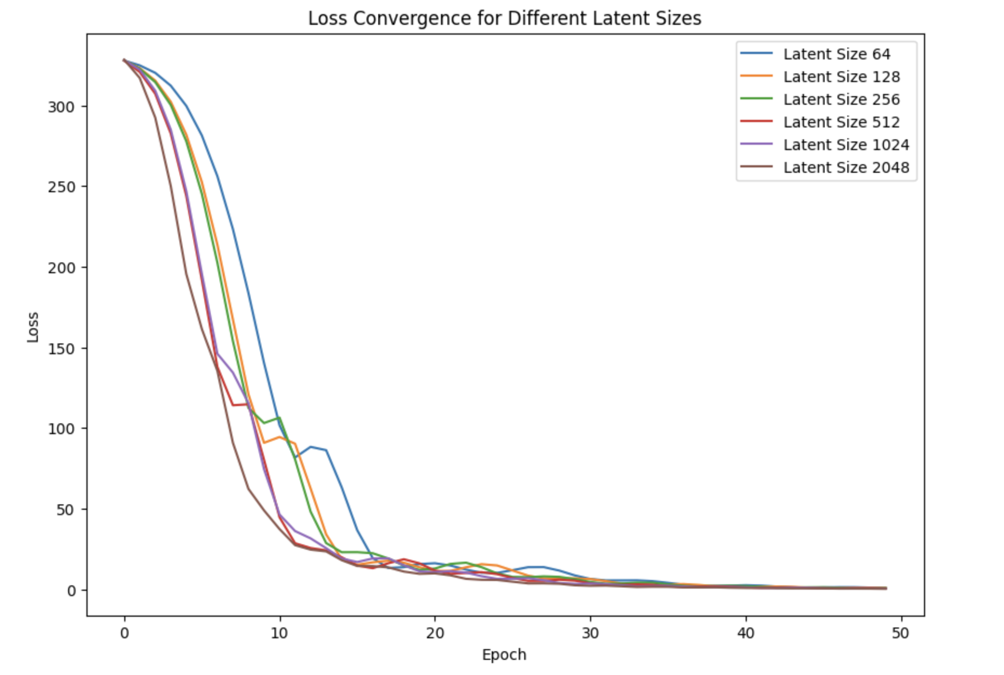
Compared Training with different lantent vector sizes

Slide 7
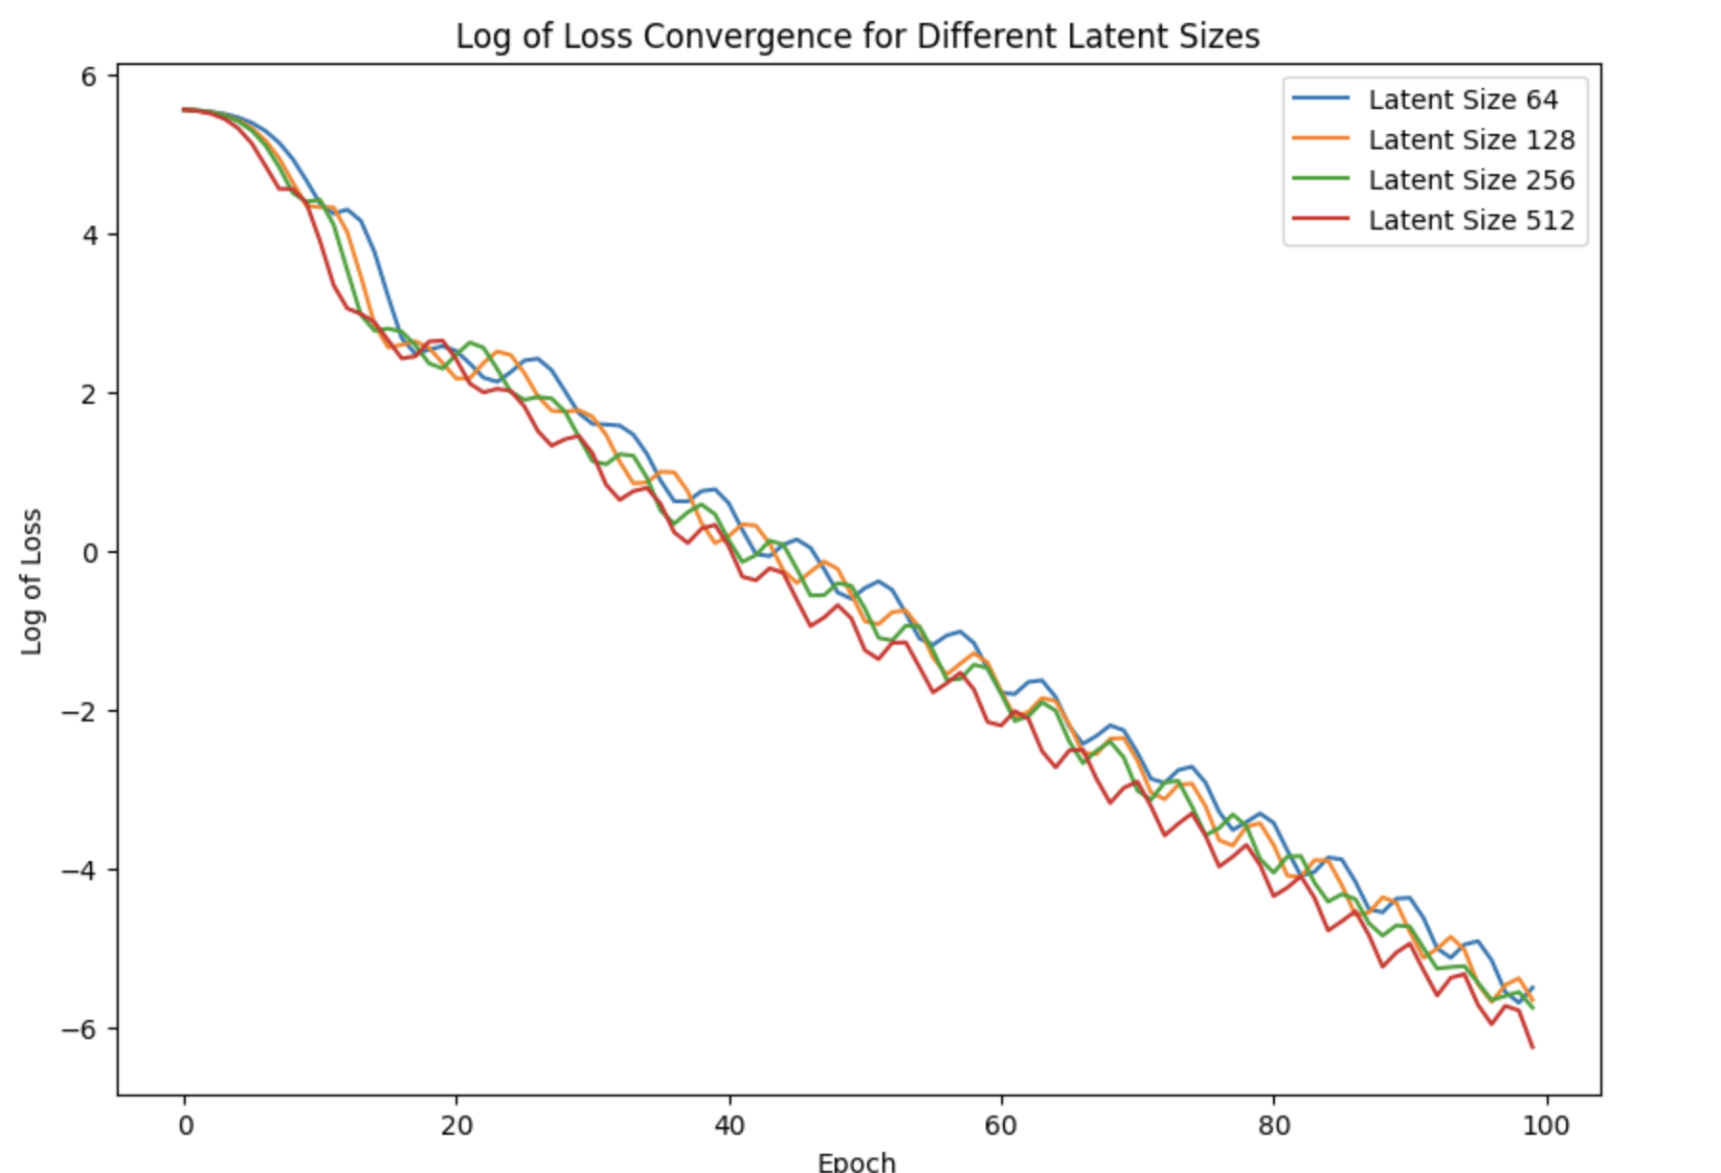
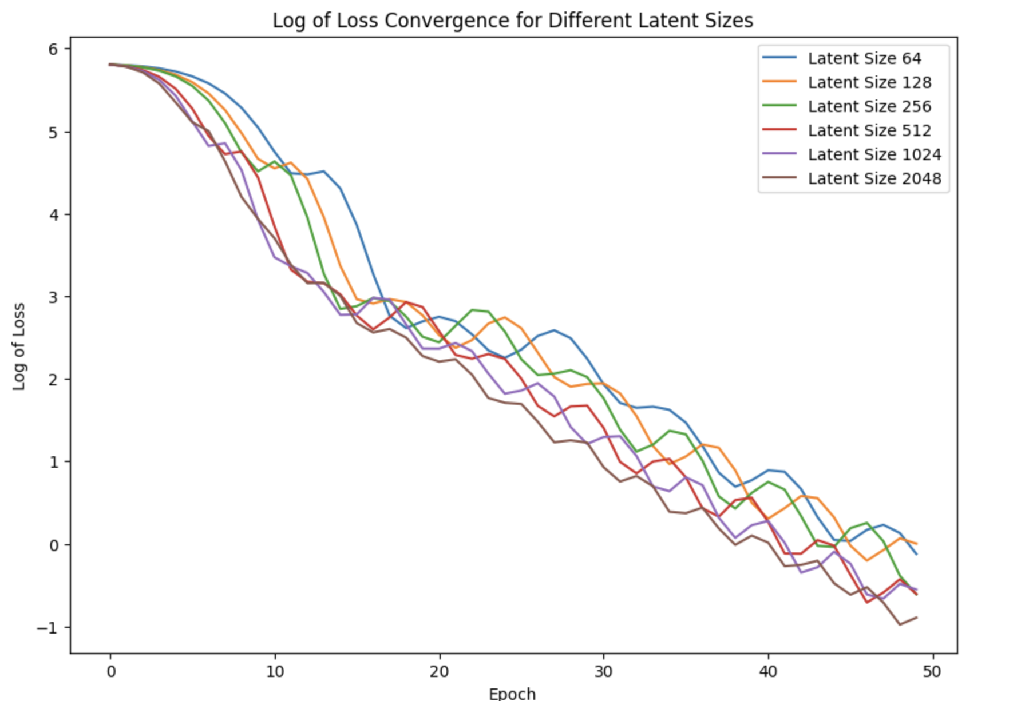
Comparing using Log

Slide 8
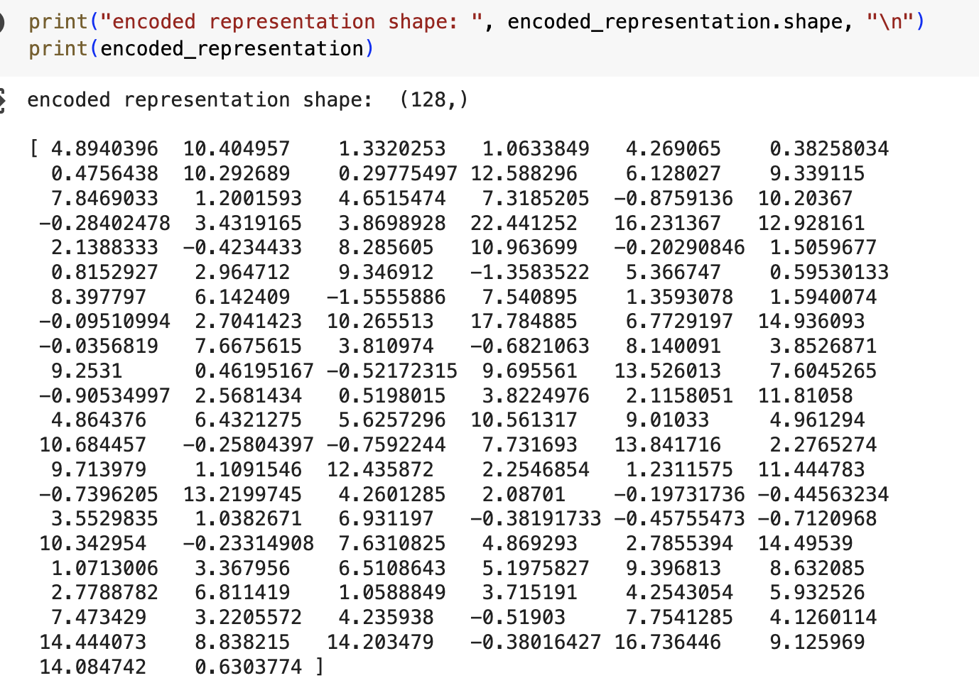
Added ability to do inference on any point cloud and get a vector representation of set shape

Slide 9
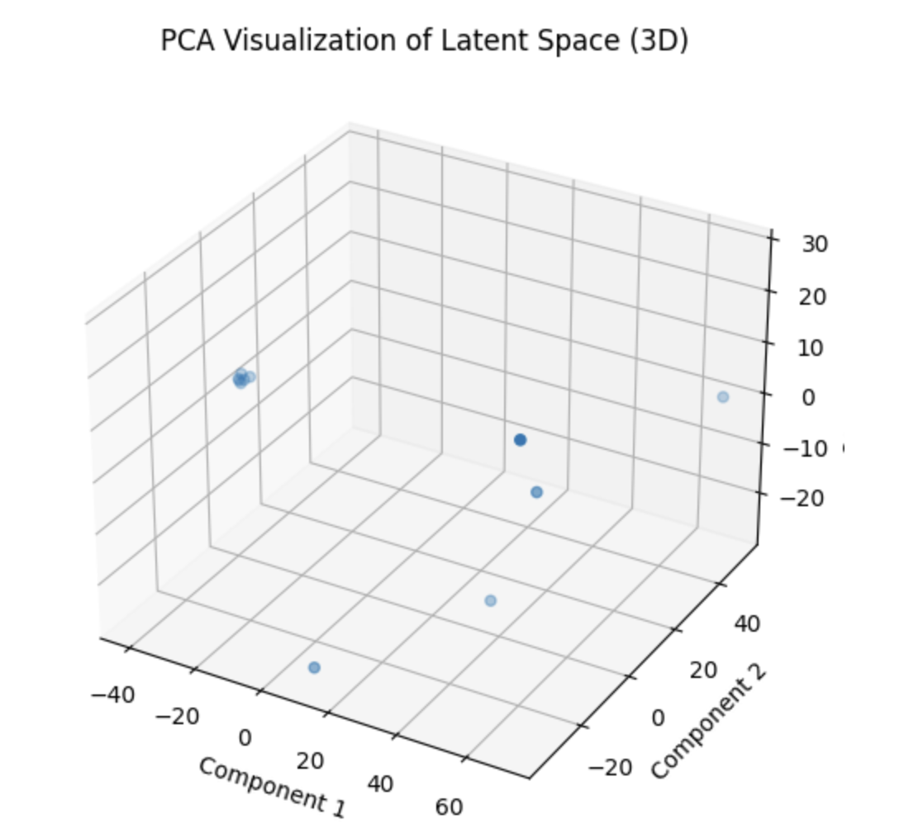
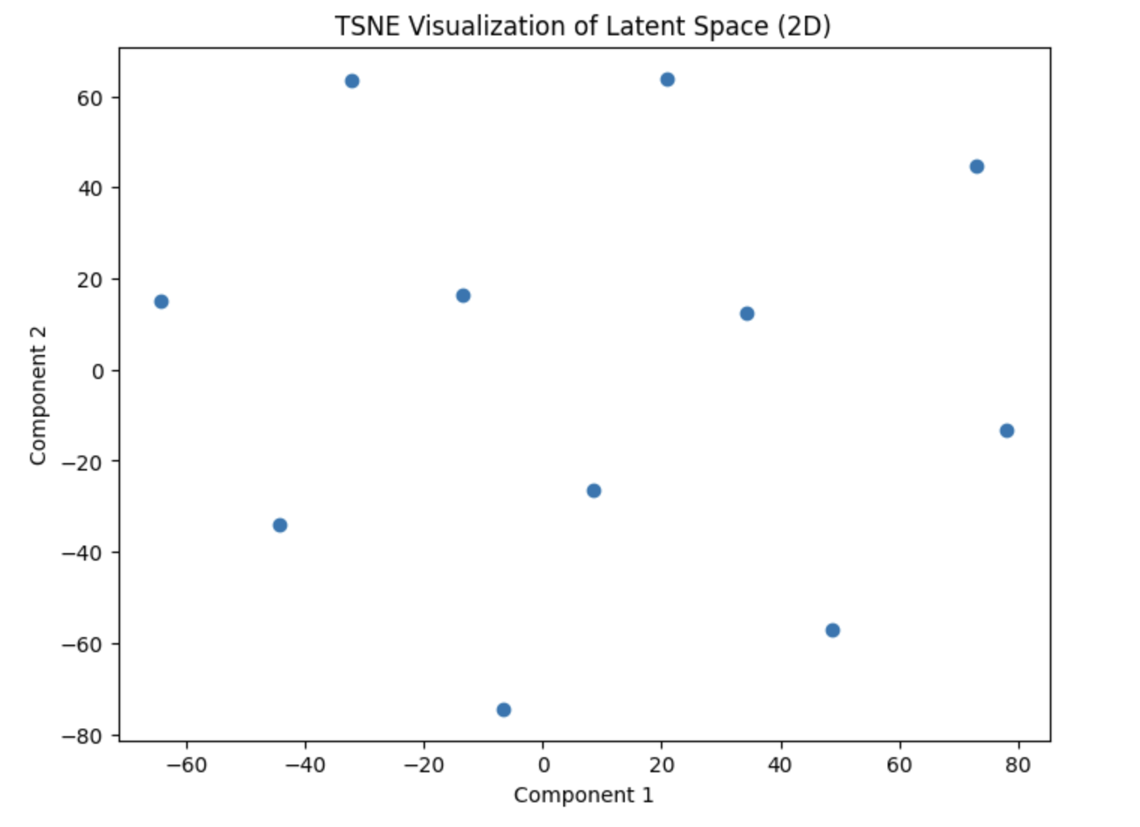
Currently experimenting with PCA and TSNE for latent visualization

Slide 10

Able to Pipeline Everything into classes
Load all point clouds
1
Down sample to fixed same point cloud size
2
Choose Encoder Decoder latent size
3
Train Model on Multiple Point Clouds
4
Do forward pass and return latent vector of test point cloud
5
Visualize training on different latent sizes using line graph
6

Slide 11
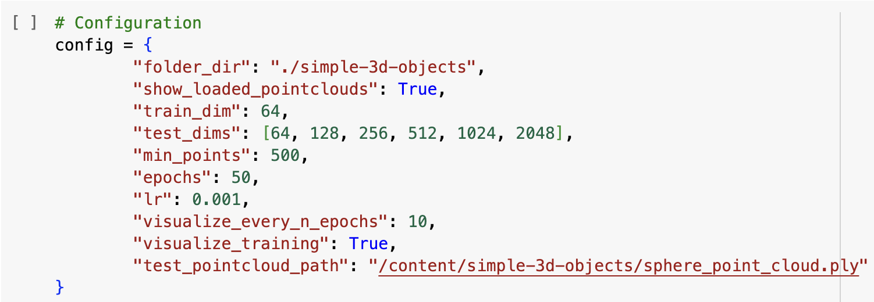
Automated Everything

Slide 12
Questions

Slide 13
What Next
Working on actual implementation for my paper
Dr. Aditya and I are having extensive discussions on the baseline
There’s some work done for actual implementation
Re reading the DeepSDF paper, and reading/running the DeepSDF code this week
Presenting next Tuesday so I can get feedback from broader audience

